Slide 1
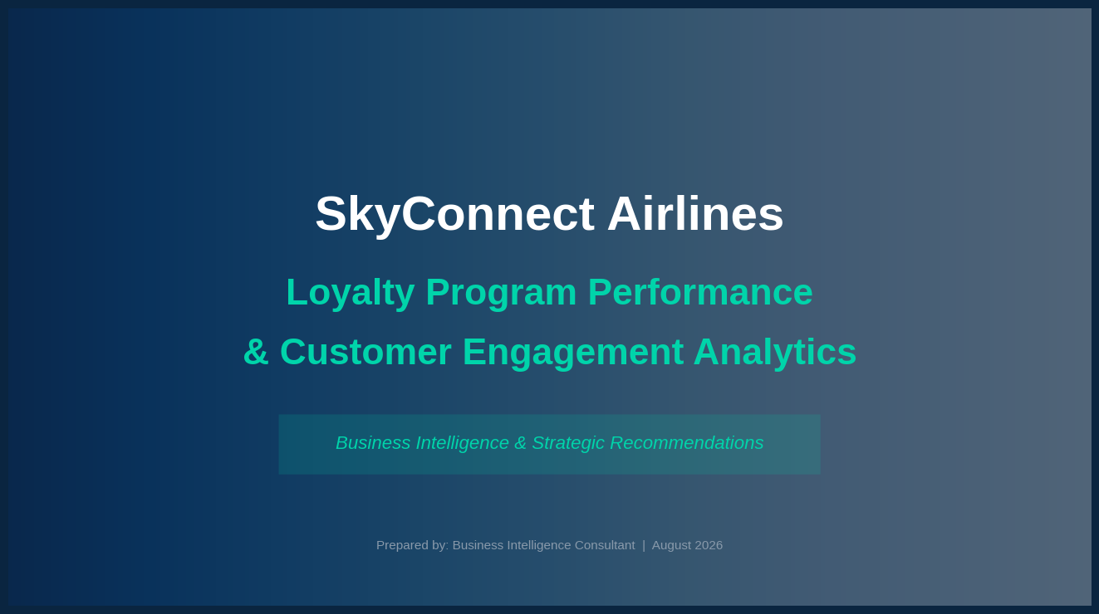


Slide 2
Business Problem & Strategic Objectives
Key Objectives
The Challenge
Sky Connect Airlines has invested heavily in its loyalty program, but the management lacks visibility into whether the program is delivering meaningful business value.
Unclear customer retention impact
Unknown high-value customer segments
Unmeasured post-enrolment behaviour changes
Untracked tier performance
Unoptimized reward redemption policies
Customer Analytics
Identify high-value customers using CLV segment by Loyalty, Salary, Education, Geography.
Loyalty Performance
Evaluate enrollment trends & cancellation rates identify the best performing loyalty tiers.
Flights Activity
Analyze to monthly, yearly travel patterns Measure customer travel Frequency
Rewards Analysis
Track points accumulation & redemption evaluate redemption cost impact
Executive Support
Strategic recommendations for retention optimize marketing & reward policies

Slide 3
Project Methodology
1
2
3
4
5
6
Business
Understanding
Data Preparation
& Cleaning
Exploratory
Data Analysis
SQL
Investigation
Business Dataset
Creation
Power BI
Dashboard
Data Sources
Customer Loyalty
History
Customer Flight
Activity
Calendar
Dimension

Slide 4
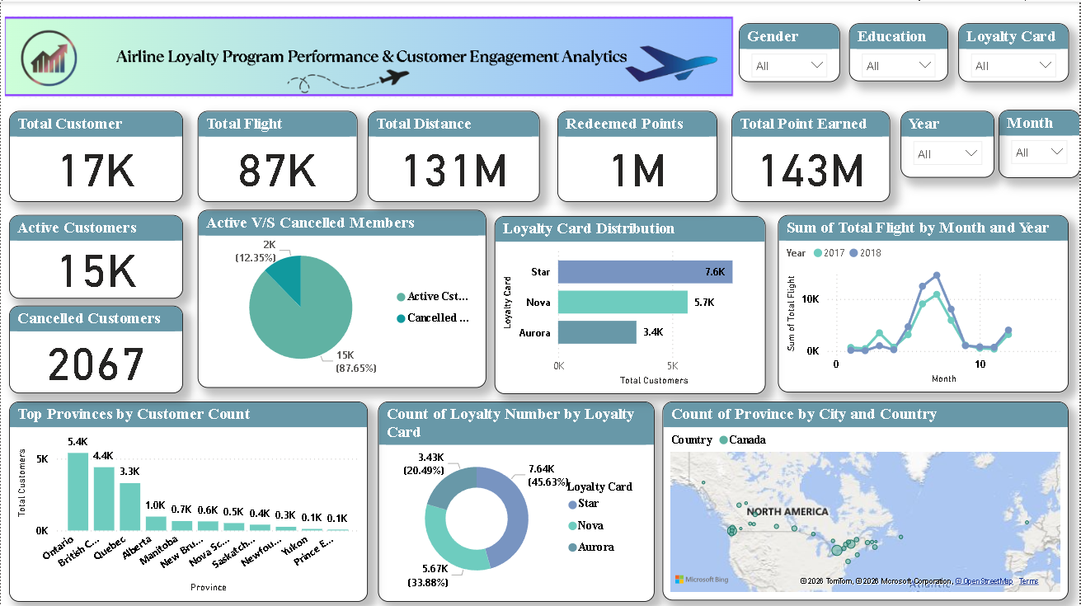
Executive Performance Dashboard

Slide 5
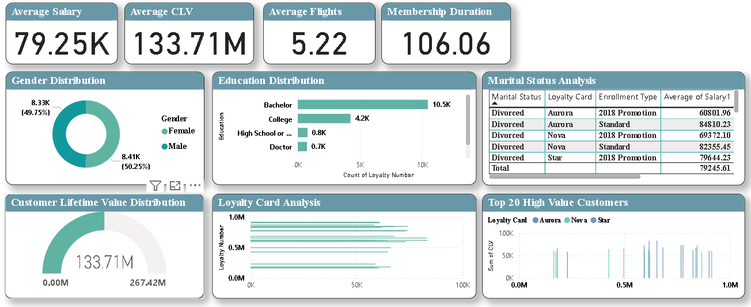
Customer Intelligence Dashboard

Slide 6
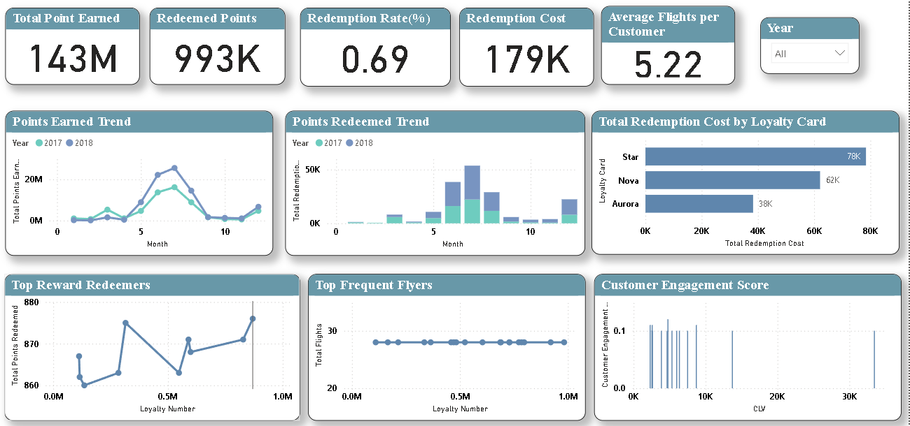
Loyalty & Rewards Performance Dashboard

Slide 7
Key Business Insights
1. Customer Retention is the Primary Driver of Business Value
The majority of revenue and Customer Lifetime Value (CLV) is generated by active loyalty members, highlighting that improving customer retention has a greater long-term impact than acquiring new customers.
2. Premium Loyalty Members Generate Higher Customer Lifetime Value
Customers enrolled in higher loyalty card tiers consistently contribute higher average CLV, making them the airline's most valuable customer segment.
3. Travel Activity Directly Influences Customer Engagement
Customers with higher flight frequency demonstrate stronger engagement through increased reward point accumulation and redemption, indicating a positive relationship between travel activity and loyalty.
4. Geographic Markets Show Different Levels of Customer Performance
Customer concentration, flight activity, and loyalty engagement vary across provinces and cities, enabling the airline to identify high-performing markets and regions requiring additional marketing investment.
5. Reward Redemption Reflects Program Effectiveness
A healthy reward redemption rate indicates that customers actively participate in the loyalty program, while customers with accumulated but unredeemed points represent an opportunity for targeted engagement campaigns.

Slide 8
Key Business Insights
6. High-Value Customers Represent a Small but Critical Segment
A relatively small percentage of customers contributes a significant share of total Customer Lifetime Value, emphasizing the importance of personalized retention strategies for premium members.
7. Seasonal Travel Patterns Influence Airline Performance
Monthly and yearly flight trends reveal clear seasonal demand, allowing the airline to optimize capacity planning, promotional campaigns, and pricing strategies during peak and off-peak periods.
8. Customer Segmentation Supports Personalized Marketing
Segmenting customers by CLV, flight frequency, salary band, and redemption behaviour enables the airline to deliver targeted marketing campaigns that improve customer satisfaction and campaign effectiveness.
9. Engagement Score Helps Identify Growth Opportunities
Customers classified with low engagement scores can be targeted with personalized offers, bonus reward campaigns, and travel incentives to improve activity and reduce future cancellations.
10. Data-Driven Decision Making Improves Loyalty Program Performance
Combining customer demographics, flight activity, loyalty behaviour, and reward analytics provides management with actionable insights that support strategic planning, operational efficiency, and long-term business growth.

Slide 9
Strategic Recommendations
1. Strengthen Retention for High-Value Customers
Insight: Use the Top 20 High Value Customers, Average CLV, and Customer Retention Rate visuals.
Recommendation:
Introduce exclusive travel benefits such as complimentary lounge access, priority boarding, and bonus reward points for customers with the highest Customer Lifetime Value (CLV).
Assign relationship managers to premium customers to improve long-term retention.
Expected Business Impact: Increased customer retention and higher lifetime revenue.
2. Launch Re-engagement Campaigns for Low-Activity Members
Insight: Use the Flight Frequency Categories, Customer Engagement Score, and Active vs Cancelled Members.
Recommendation:
Target customers classified as Occasional Travelers or Low Engagement with personalized email campaigns, limited-time discounts, and bonus point offers.
Encourage inactive members to complete at least one trip within a promotional period.
Expected Business Impact: Higher flight frequency.
3. Improve Reward Redemption Participation
Insight: Use Total Points Earned, Total Points Redeemed, and Redemption Rate.
Recommendation:
If redemption rates are low, simplify the redemption process and promote reward availability through the mobile app and email.
Introduce limited-time double-value redemption events to encourage customers to use accumulated points.
Expected Business Impact: Increased customer engagement and stronger perceived value of the loyalty program.

Slide 10
Strategic Recommendations
4. Expand Marketing in High-Performing Regions
Insight: Use Customer Distribution by Province, Top Provinces by Customer Count, and Flights by Province.
Recommendation:
Increase marketing investment in provinces with high customer growth and strong travel activity.
Replicate successful campaigns from top-performing provinces in regions with lower customer acquisition.
Expected Business Impact: Increased enrolment and improved regional market penetration.
5. Optimize Loyalty Card Benefits
Insight: Use Loyalty Card Distribution, Average CLV by Loyalty Card, and Redemption Cost by Loyalty Card.
Recommendation:
Review loyalty tiers that have high redemption costs but low customer value.
Enhance benefits for tiers that consistently generate higher CLV and stronger customer engagement.
Expected Business Impact: Better profitability and more effective loyalty program management.
6. Increase Membership Growth
Insight: Use Customer Enrolment Trend and Membership Growth Rate.
Recommendation:
Introduce referral programs, welcome bonus points, and co-branded credit card partnerships to attract new members.
Focus promotional campaigns during months with historically lower enrolment.
Expected Business Impact: Faster loyalty program growth and a larger active customer base.

Slide 11
Business Impact
Initiative | Expected Business Benefit
Customer Retention Programs | Increased repeat customers and higher CLV
Personalized Marketing | Higher conversion rates and better campaign performance
Reward Program Optimization | Increased engagement with controlled redemption costs
High-Value Customer Focus | Greater profitability from premium customer segments
Data-Driven Dashboards | Faster decision-making and improved operational efficiency
Flight Trend Analysis | Better resource utilization and demand forecasting

